Slide 1
Module 7.8
Email Security, Certificates

Slide 2
Email Security:
Pretty Good Privacy (PGP)

Slide 3
E-Mail Security
Security goals
  Confidentiality: only intended recipient sees data
  Integrity: data cannot be modified en route
  Authenticity: sender and recipient are who they say
Security non-goals
  Timely or successful message delivery
  Avoiding duplicate (replayed) message
  (Since e-mail doesn’t provide this anyway!)

Slide 4

Sender and Receiver Keys
If the sender knows the receiver’s public key
  Confidentiality
  Receiver authentication
If the receiver knows the sender’s public key
  Sender authentication
  Sender non-repudiation

Slide 5
Sending an E-Mail Securely
Sender digitally signs the message
  Using the sender’s private key
Sender encrypts the data
  Using a one-time session key
  Sending the session key, encrypted with the receiver’s public key
Sender converts to an ASCII format
  Converting the message to base64 encoding
  (Email messages must be sent in ASCII)

Slide 6

Public Key Certificate
Binding between identity and a public key
  “Identity” is, for example, an e-mail address
  “Binding” ensured using a digital signature
Contents of a certificate
  Identity of the entity being certified
  Public key of the entity being certified
  Identity of the signer
  Digital signature
  Digital signature algorithm id

Slide 7
Web of Trust for PGP
Decentralized solution
  Protection against government intrusion
  No central certificate authorities
Customized solution
  Individual decides whom to trust, and how much
  Multiple certificates with different confidence levels
Key-signing parties!
  Collect and provide public keys in person
  Sign other’s keys, and get your key signed by others

Slide 8
HTTP Security

Slide 9


HTTP Threat Model
Eavesdropper
  Listening on conversation (confidentiality)
Man-in-the-middle
  Modifying content (integrity)
Impersonation
  Bogus website (authentication, confidentiality)

Slide 10
HTTP-S: Securing HTTP
HTTP sits on top of secure channel (SSL/TLS)
  https:// vs. http://
  TCP port 443 vs. 80
All (HTTP) bytes encrypted and authenticated
  No change to HTTP itself!
Where to get the key???
HTTP
Secure Transport Layer
TCP
IP
Link layer

Slide 11
Learning a Valid Public Key
What is that lock?
  Securely binds domain name to public key (PK)
    If PK is authenticated, then any message signed by that PK cannot be forged by non-authorized party
  Believable only if you trust the attesting body
    Bootstrapping problem: Who to trust, and how to tell if this message is actually from them?

Slide 12
Hierarchical Public Key Infrastructure
Public key certificate
  Binding between identity and a public key
  “Identity” is, for example, a domain name
  Digital signature to ensure integrity
Certificate authority
  Issues public key certificates and verifies identities
  Trusted parties (e.g., VeriSign, GoDaddy, Comodo)
  Preconfigured certificates in Web browsers

Slide 13
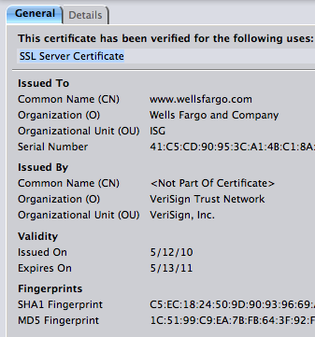
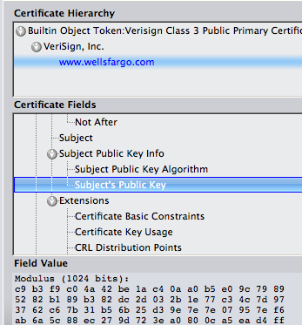
Public Key Certificate

